Slide 1
CUDA:
GRAVITY SIMULATION w Ray Tracing

Slide 2
Shizhe Yang
OLISADEBE OJUKWU
Introduction
Methodology
Optimization
Results
Analysis
Conclusion

Slide 3
Introduction
CUDA can accelerate calculation in parallel drastically.
We acquired the idea of completing a CUDA project through
Mandelbrot homework.
During Mandelbrot homework, we explored ways to optimize
and analyze our codes.

Slide 4

Mandelbrot Idea:
Huge Speed Up
Compared to CPU, GPU acceleration is enormous.
Most ideal case: for 100 million iterations, speed up is 10x.
Limitations
For GPU, it costs a lot of cycles if some of the threads are idle.
If-else statements will cause some threads to execute while other threads are waiting.
CPU is extremely slow compared to GPU
Inspiration
GPU has huge advantages over CPU on repeated, single-precision, parallel processing of images. So we want to do a project on CUDA parallel processing on generating gravitational simulation images.
Explain how your product or service helps your persona to achieve their goals and solve their pain points.

Slide 5
Methodology
We create the gravity simulation based on the naive
Brute-force simulation file provided in ECE451 repo.
Starting from the CPU version, then we convert the CPU
Version to GPU version for acceleration.

Slide 6
Workflow
Initial Work
CUDA generate
Optimization
Results
Analysis
Conclusion
Rewrite Gravity Simulator Cpp file.
Rewrite a header file and put the Planet Body class inside for better readability
Based on the brute-force Cpp file, rewrite it into CUDA functions.
For both velocity-position generation and frame rendering
Optimize CUDA codes. Understand the bottleneck of CUDA kernel executions
Generate output file to store the planets’ velocities and positions.
Based on the positions and velocities, generate each frame and convert it with ffmpeg
Benchmark performance by comparing CPU and GPU, and GPU with optimization techniques.
Use Nsight compute to acquire more detailed analysis
What we have learned from this project.
What can we improve in the future. (Algorithm and CUDA logics)

Slide 7
Working Environment Setup
NVIDIA RTX 3070Ti Overclock
8.6 Compute Capability(Advanced Ray Tracing Support)
6144 Cuda Cores
48 Ray Tracing Cores
8196 MB GDDR6 Memories
CPU
INTEL I7-12700K(5.0Ghz max frequency)
AVX-2(AVX512 BLOCKED)
64GB DDR5-4000Mhz
GPU
Nsight Compute 2025.4.0
Nsight System 2025.3.2
Google Gemini
Matlab
Compiler
GNU g++ 15.1.0
NVCC Cuda-kit 13.0
ffmpeg
Analysis
Tool

Slide 8
Optimization
We tried to identify the bottleneck and what is causing the
Latency in our codes. We focus on memories usages and
Divergence problems. Partition workload between CPU and
GPU is crucial

Slide 9
For example:
Velocity and Position are
Co-dependent!
Cannot compute velocity without computing position first.After stepping forward in time, velocity needs to be calculated using the new position!
Memory Usages
Threads are always accessing the global memories. Cache hit rate is high but still not solving the locality problem. Need to use registers more to speed up the program
Host-Device
Constantly copying memories from host-device, back and forth. It wastes huge amounts of time, as threads will be idle waiting for the data. Need to balance the workload
Algorithms
Threads throttling issue occurs frequently in the program execution process. If-else statement costs a lot of time for threads to wait while other threads are executing.Sometimes loop is inevitable

Slide 10
Optimization Process
Data Structure
Balance Workload
Grid and Block Size
Algorithms
Memory Usages
Improve Data Structure
std::vector<Body> Bodies
To
Std::vector<std::vector<Body> Bodies> Bodies
Store the entire loop history data inside one vector, so the memory access will be sequential
All calculations and ray tracing to be done on GPU
CPU is only used to write out data to txt file
For each GPU architecture, there’s an optimized block size.
For 3070Ti Ampere architecture, it is recommended to use 256 threads per block.
Minimize if-else statement in GPU kernel to prevent threads from stalling
Use float instead of double, since Ampere architecture for 3070Ti has more FP32 cores than FP64 cores, meaning more single-precision calculation per cycle
Maximize memory usage on GPU so that memory transfer time between CPU and GPU is minimized

Slide 11
Optimization Example: (pseudo codes)
Huge time improvement!
Warps will be idle in condition switching! While loop in for loop wastes a lot of time
Copy and print to file every iteration
Do not copy data for each time step forward
for (t < END) {
copy_device_to_host(bodies, h_x, h_y, h_z, h_vx, h_vy, h_vz, d_x, d_y, d_z, d_vx, d_vy, d_vz);
print_toFile(bodies);//print every time
while (t < END) {
update_velocities<<<blocks, threads>>>(n, d_m, d_x, d_y, d_z, d_vx, d_vy, d_vz, step_dt);
cudaDeviceSynchronize()
update_positions<<<blocks, threads>>>(n, d_x, d_y, d_z, d_vx, d_vy, d_vz, step_dt);
CUDA_CHECK(cudaDeviceSynchronize());
}
}
while (t < END) {
update_velocities<<<blocks, threads>>>(n, d_m, d_x, d_y, d_z, d_vx, d_vy, d_vz, step_dt);
cudaDeviceSynchronize();
update_positions<<<blocks, threads>>>(n, d_x, d_y, d_z, d_vx, d_vy, d_vz, step_dt);
}

Slide 12
Results
A short video is generated as the final result.
We can do a live demo (if time permitting)

Slide 13
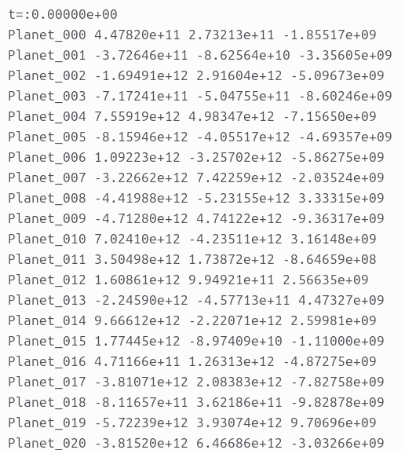
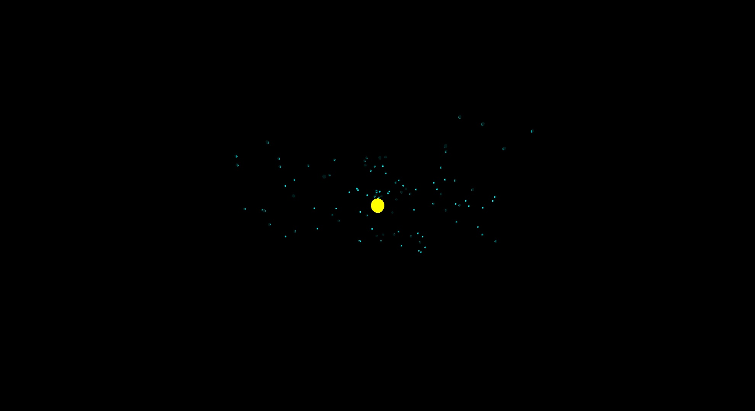
Steps:
1
Generate a txt file by Gravity simulation containing all history data ranging from t=0 to t=1 year
Name, x,y,z
Based on the generated txt file.
Read the file and use ray tracing to generate each frame for the entire timeline. Since total number of frames will be large, we will only generate certain frames and abort the application.
2
3
Generate a video using ffmpeg package on Linux

Slide 14

Final Result

Slide 15
Analysis
Nvidia provides system and kernel wide tools for
analyzing memory, core usages, and many other metrics

Slide 16
1
Compare kernels in Gravity Simulation
2
Analyze Ray Tracing Kernel Performance
3
Benchmark

Slide 17
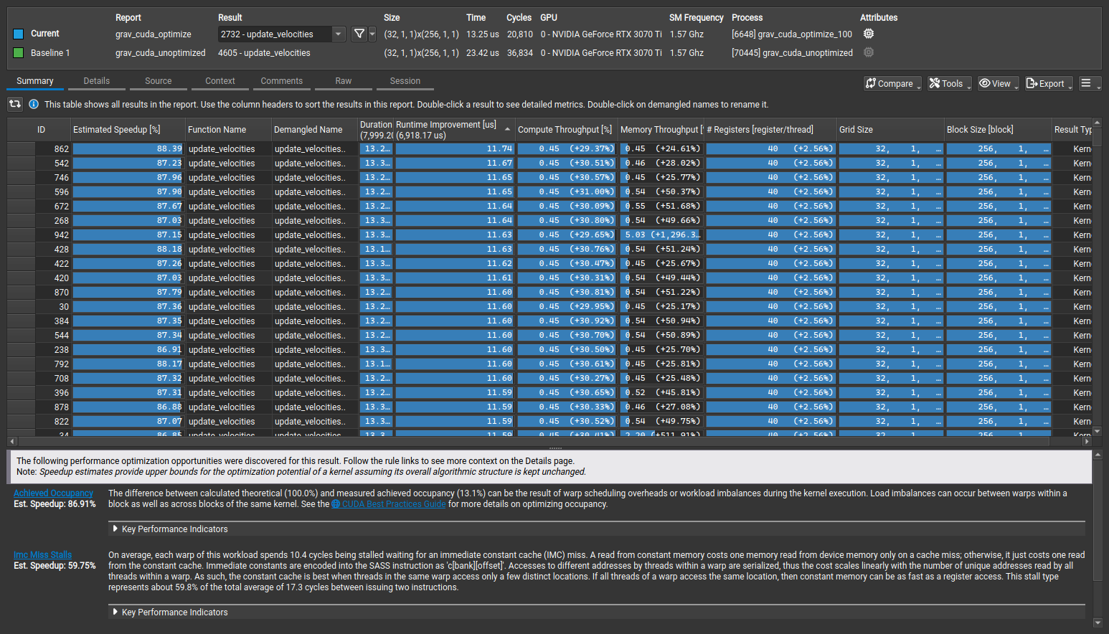
Analysis : Kernel Comparison-Velocity Calculation
1
Baseline:unoptimized, Target: optimized
Metrics
RunTime- Ave 11 us improvement
Throughput 30%
Register Usages 3%
Overall Speed up 86.91%

Slide 18
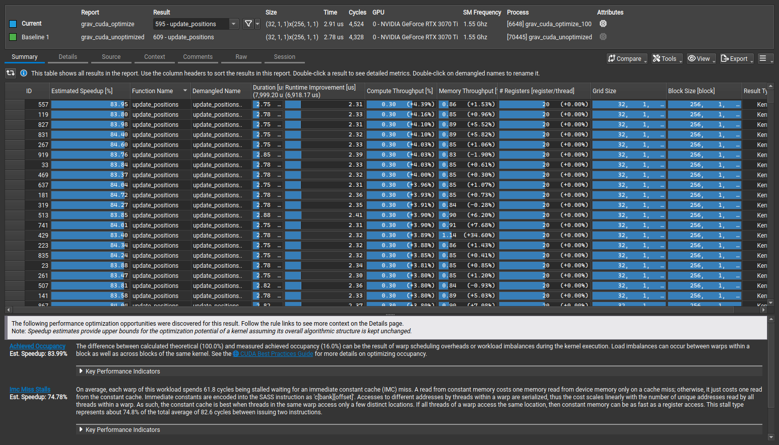
Analysis : Kernel Comparison-Position Calculation
1
Baseline:unoptimized, Target: optimized
Metrics
RunTime- Ave 2 us improvement
Throughput 3%
Register Usages 0%
Overall Speed up 83.99%

Slide 19
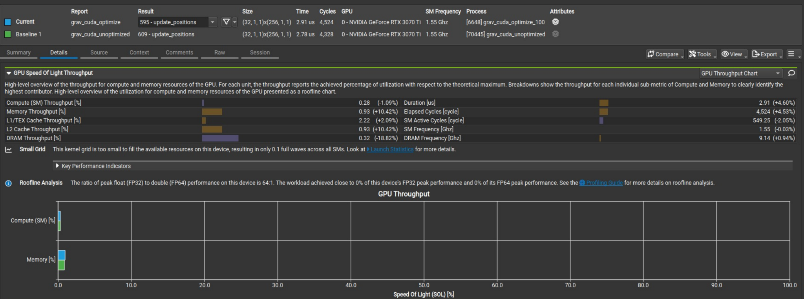
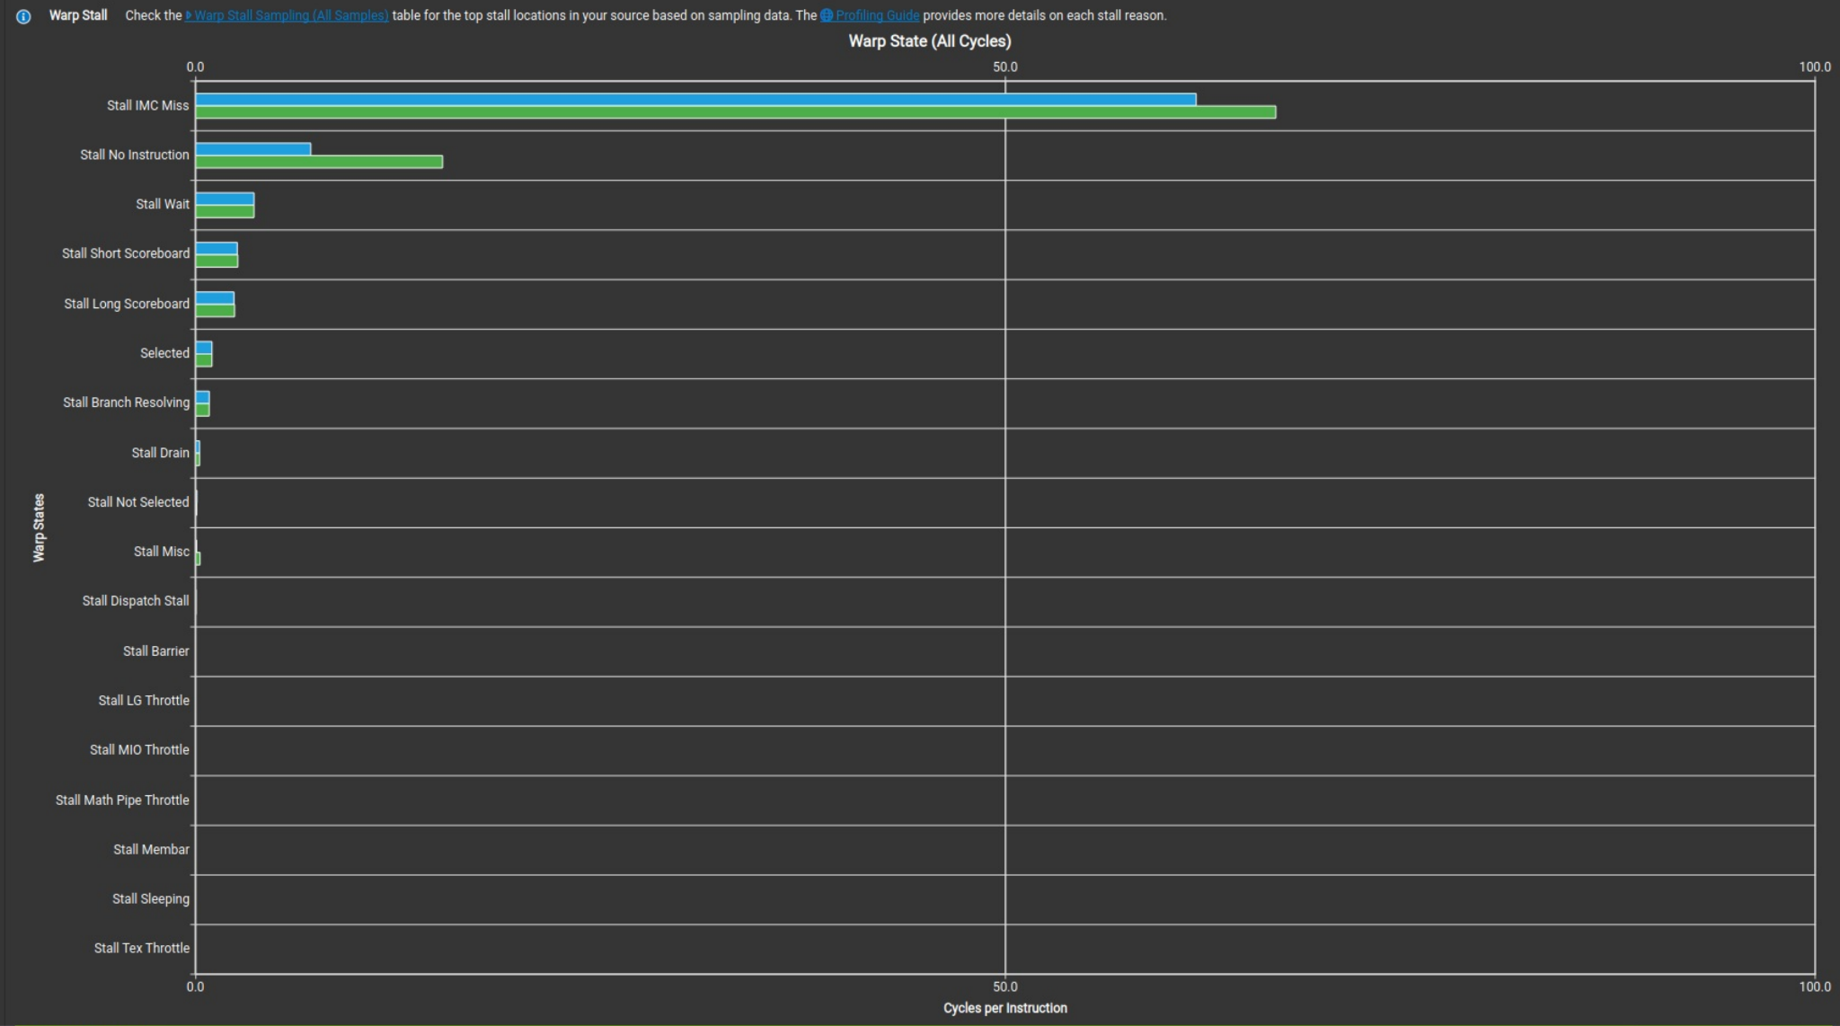
Problem with both versions-position,velocity
1
1
Throughput
Warp Miss
Extreme low overall throughput.
Most cores are idling and do not compute any results
Many warps are stalled. Biggest assumption is that these warps have divergence problem as they are idle in a loop.
1
1
Memory
Compute Usage
Local memory is hardly used. Each block is accessing global memory every cycle.
Extremely low peak computing power utilization. Most SMs are not filled.

Slide 20
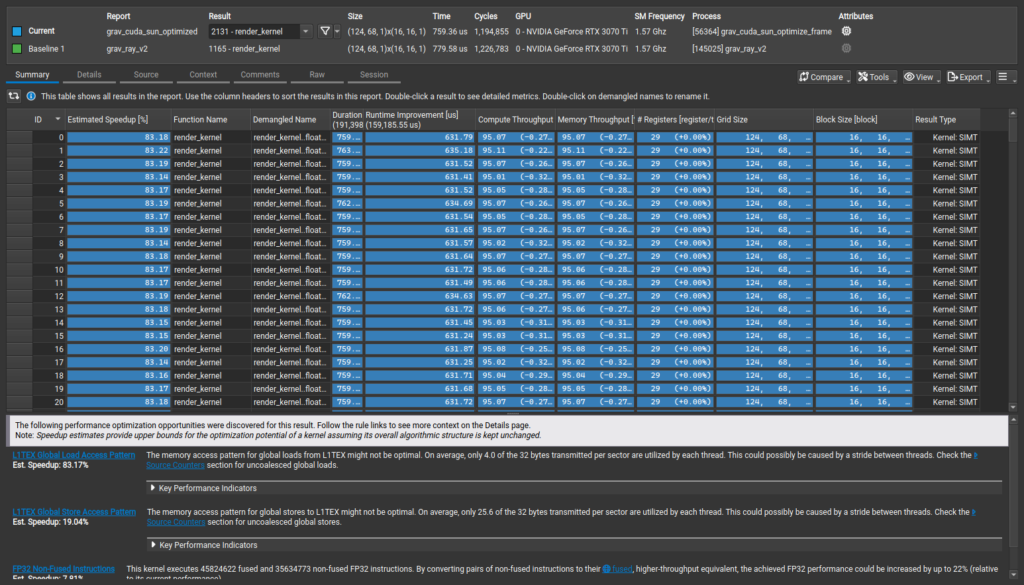
Performance Analysis: Ray Tracing Rendering-Comparison
2
Key Findings:
Analysis shows that two version have basically no difference.
The reason should be that Sun is always at the origin,as a fixed point. So the rendering kernel always need to render the frame,no matter if the program needs to read the position from file or not.

Slide 21
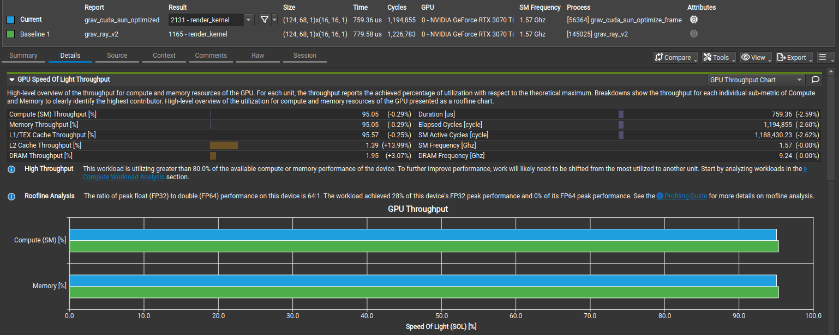
Performance Analysis: Ray Tracing Rendering-Comparison
2
Throughput
Compute Workload
Both versions have great throughputs. But still don’t fully use device’s cores.
Both versions have at least 85% workload on the SMs that are being used. Indicating good resource usages.

Slide 22
Benchmark
3
GPU vs. CPU
optimized vs. unoptimized
Iteration through 1 year,compute time
100 Planets:
CPU:2.5 minutes
GPU:0.97 minutes
1000 Planets:
CPU:2.54 hours
GPU:1.56 minutes
10000 Planets:
CPU:31.57 hours
GPU:1.24Hour
1M Planets:
CPU: Dead
GPU: 28.2 hours
Iteration through 1 year,compute time
100 Planets:
OPTIMIZED:0.6 minutes
UNOPTIMIZED::0.97 minutes
1000 Planets:
OPTIMIZED:1.36min
UNOPTIMIZED:1.56 minutes

Slide 23
Conclusion
What we’ve learned from this project
What we hope to do to keep improving this project
What we didn’t do well, and what we’ve done well

Slide 24
What can we improve?
What have we learned
In the future
Need to drastically increase grid size. SMs need to be saturated in order to fetch instructions more efficiently
Still need to figure out how to use more registers, and make the program use more local memory than accessing global memory to reduce latency
Still need to fix divergence problem
Bottleneck of CUDA program
How to use Nsight tools
Handle divergence
Use more complicated ray tracing platform, such as Nvidia Optix
Replace Sun with a black hole, and render the frame with truth black hole simulation

Slide 25
References
“Unleashing the Power of NVIDIA Ampere Architecture with NVIDIA Nsight Developer Tools.” NVIDIA Technical Blog, 14 May 2020, https://developer.nvidia.com/blog/unleashing-power-of-nvidia-ampere-architecture-with-nsight-developer-tools/.
“Using Nsight Compute to Inspect Your Kernels.” NVIDIA Technical Blog, 28 Aug. 2024, developer.nvidia.com/blog/using-nsight-compute-to-inspect-your-kernels.

Slide 26
Thank you

